Slide 1
Coursera Capstone Project
Topic: Identify business opportunities and competitor analysis in New York city.

Slide 2
Introduction
Based on previous research, the interest by consumers in the premium coffee house industry is getting popular in recent years.
The ideal premium coffee shop will provide a friendly, comfortable atmosphere where the customer can receive quality food, service and entertainment at a reasonable price.
Besides that, the premium type coffee house will offer a variety of choices to the customers. The product choice included:
Coffee
Tea
Juice
Soda and non-alcoholic beverages.

Slide 3
Identify the problem
My relatives would like to open a coffee shop in New York City. However, she lack of knowledge about this industry.
The previous studied show the location of premium coffee shop is one of the essential elements to be success in this industry.
A strategic location can easily expose to huge traffic of people therefore enhance the probability of people to enter the shop and spend for a coffee.
Therefore, this report would like to explore the business opportunity of coffee shop and strategic location in the area of New York City.
The objectives of this project as show below:
Identify the coffee shop business opportunity in New york city
Identify the competitor and analyze competitor movement
Identify the suitable location for coffee shop business

Slide 4
Data acquisition and Methodology
Data:
Data type - Secondary Data
Data Source – New York City neighborhood repository
Data attribute - Neighborhood name, Latitude, Longitude
Tool:
Notebook - Jupyter Notebook
Language – Python language
Python library - Pandas, Folium
Location services provider – Foursquare API

Slide 5
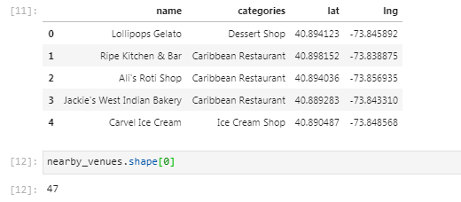
Result
Firstly, there are total 47 shops in the area. Below is the result

Slide 6
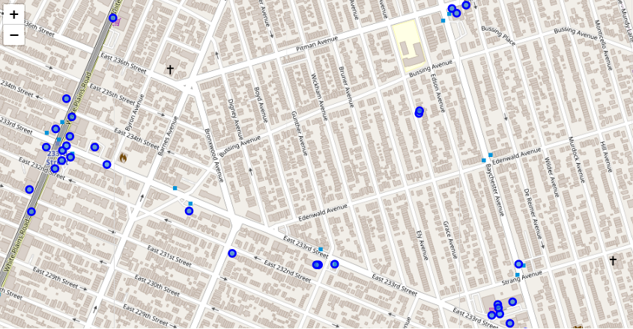
Result
Then, I had visualized the data as a map by using folium library.
The results show the shops are quite concentrated in few places. Below is the result.

Slide 7


Result – Identify coffees shop business opportunities
Then, I checked got how many coffee shop in the city in order to identify the competitors. However, the results showed there is no coffee shop in the city. Below is the result.
Since there is no any direct competitor in the city, therefore, I shift the analysis target to other indirect competitor such as dessert shop.
Based on the result, there is only one shop is categories as dessert shop.

Slide 8
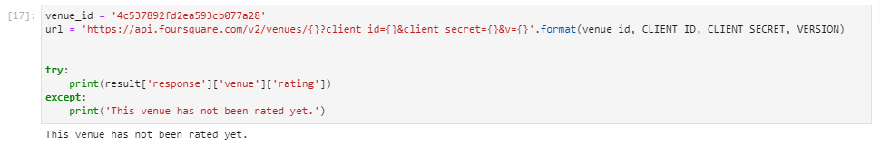
Result – competitor analysis
Then, I further analysis the Dessert shop by using Foursquare API tool. I tried to obtained the shop rating but there is no any rating to the shop. Below is the result
After that, I tried to get the comment from Foursquare’s user to the Dessert shop. The result shows there are 3 agree and 0 disagree. The comment of user is positive as well. Below is the result.

Slide 9
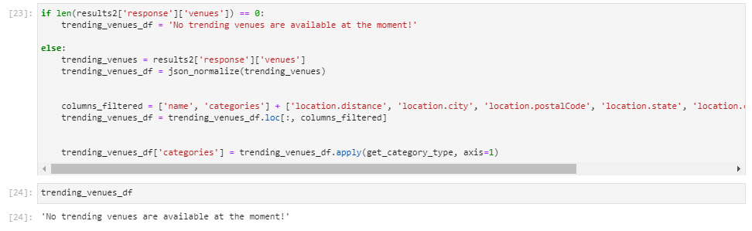
Result – competitor analysis
Moreover, I further checked whether there are any trending venues nearby the dessert shop. The result show there is no any trending venues nearby the dessert shop. Below is the result.

Slide 10
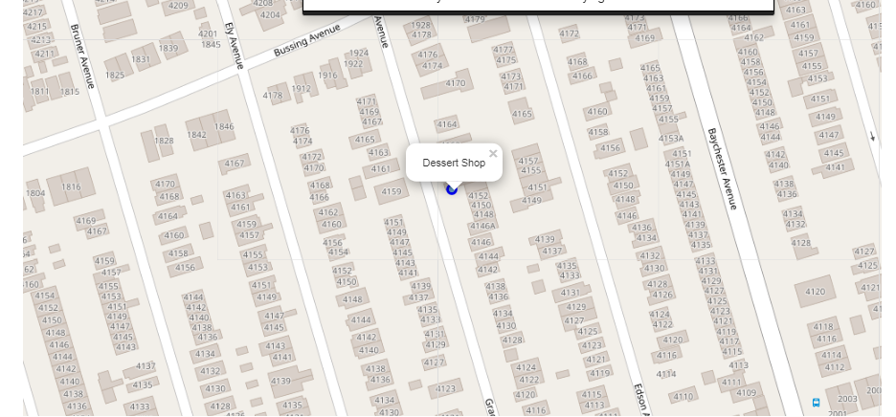
Result – competitor analysis
Then, I checked the surrounding of the dessert shop by using the folium library. The result show the location of the shop is not located in the business area such as surround by Bank, School and Office. Basically, the nearest shop is only Gas station. Therefore, it might be the reason there is not any trending venue nearby. Below is the result

Slide 11
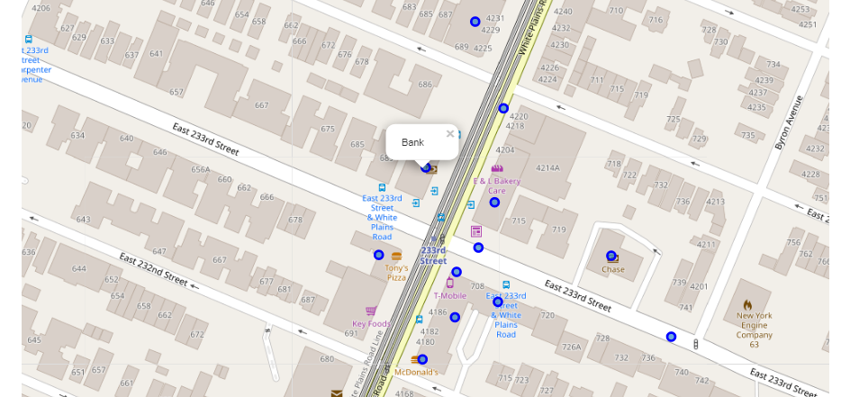
Result – Identify suitable location for coffee shop
Lastly, I analyzed which area will have more business activities and I found the surrounding of bank have more business area. Below is the result

Slide 12
Discussion of result
Based on the result show;
No any coffee shop in this area.
Have other indirect competitor such as dessert shop.
No any rating which is difficult to judge the popularity of this indirect competitor in this area.
they are having some positive comment which indicates the product is still acceptable by the consumer.
The shop is not located nearby the trending venue or business area which may result them loss of traffic of people.
Open coffee shop surround nearby the bank would be a better choice due to surrounding of bank has many business activities and shop.

Slide 13
Recommendation and conclusion
Recommendation:
Low risk to open a coffee shop in the area.
Do not have any direct competitor which is coffee shop.
Instead, open coffee shop can provide a new thing to let the neighborhood to experience.
The strength and weakness of indirect competitor
Strength – Product. (Customer leave positive comment on the taste of product)
Weakness - Location ( No trending venue and shop nearby)
Location is important due to a good product need a platform to expose to public.
Suggest to open the coffee shop in the business area or near trending venue.
Help to exposure to high traffic of people and attract people with excellent product.
The ideal location of coffee shop - located nearby the banks which there are having a lot more business opportunities.

